Slide 1


Ghostbuster
understanding and overcoming the pitfalls of transient execution vulnerability checkers
Andrea Mambretti
(mbr@ccs.neu.edu)
Pasquale Convertini, Alessandro Sorniotti, Alexandra Sandulescu and Anil Kurmus
IBM Research - Europe
Engin Kirda
Northeastern University

Slide 2
Transient Execution Attacks - Spectre BTB
Use Cases
Attacker | Victim
User | Kernel
Sandbox | Process
User | User
VM guest | Host
Host | SGX
Branch Target Buffer
Victim
Attacker
Evil
Location
A
Location 2
B
Location 3
Evil
Location
C
ATTACKER TRAINING
VICTIM HIJACKED
VICTIM NORMAL EXECUTION
Notes:
In a spectre BTB attack, the attacker has the ability to control values inside the branch target buffer that can hijack the control flow of the victim

Slide 3
Mitigations
Software
Hardware
Memory Fencing
IBRS
IBPB
Retpoline
KPTI
STIBP
RSB Filling
Branchless Masking
etc.
etc.
Spectre-BTB: >6 applicable mitigations.
Verifying that transient execution variants are mitigated is complex.
Notes:
Underline the mitigations for V2, show that there are many and it is confusing

Slide 4
Empirical
They collect success information of PoCs using:
Cache covert channel (e.g., Transientfail)
Performance counters (e.g., Speculator)
Limitation: reports the presence of the attack vector in a synthetic scenario. Cannot tell the system has an exploitable vulnerability.
Notes:
The empirical tool are based on PoC which can implemented in various ways (e.g. cache covert channel, PMC) and they test the for only the attack vector

Slide 5
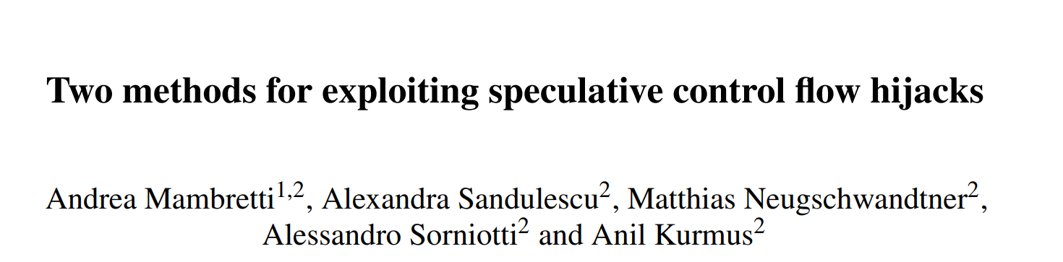
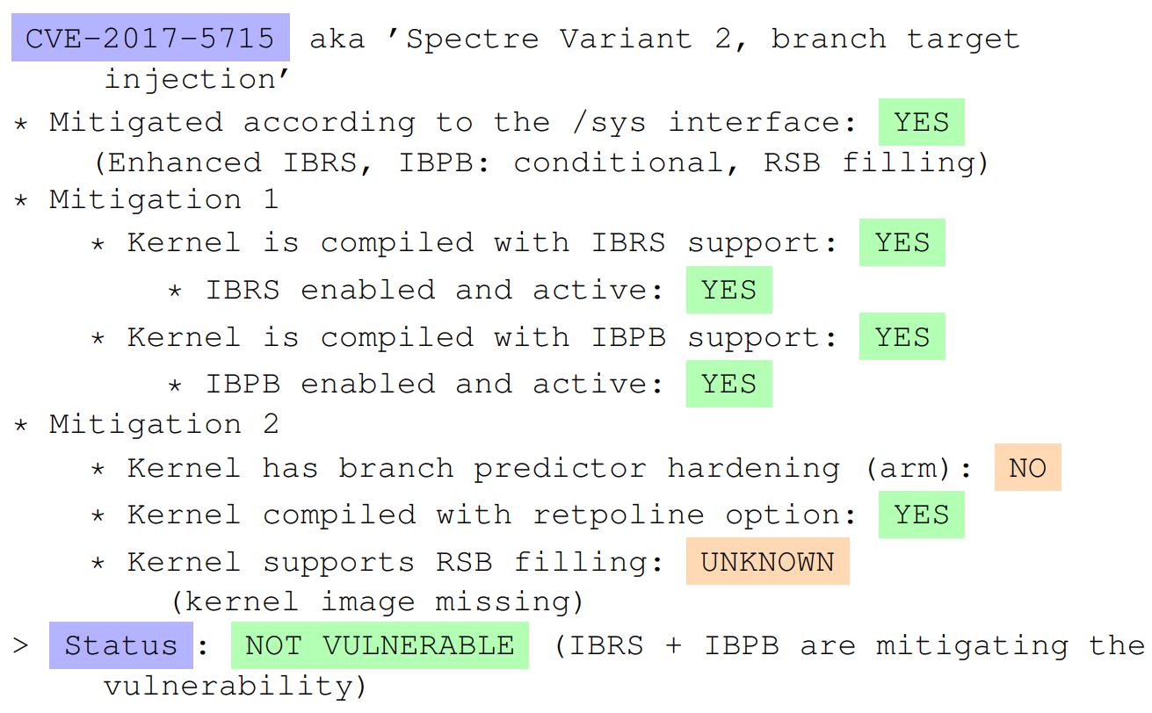
Information Gathering
They collect information from:
The CPU (e.g., microcode)
The Kernel (e.g., mitigations)
INACCURATE
Tools:
spectre-meltdown-checker
mdstool-cli
Notes:
Show that the information provided are misleading, using as example information gathering tools

Slide 6
Analysis - Pitfalls identified
Use case imprecision
Attack vector only
Parsing error
Cache noise
PMC requirement
Root requirement

Slide 7
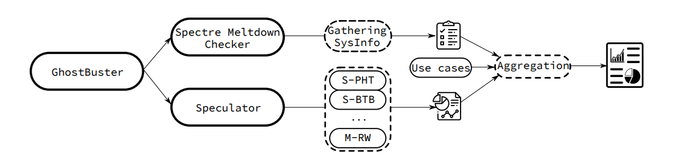
GhostBuster

Slide 8
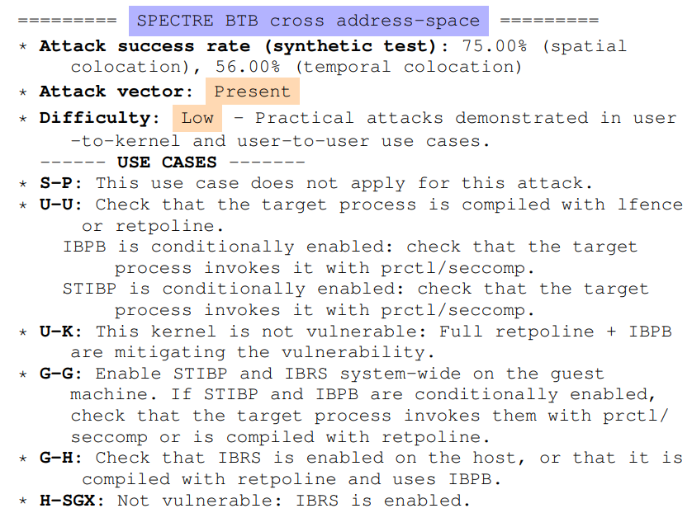
GhostBuster - Spectre BTB Example

Slide 9
Conclusions
First analysis of transient execution vulnerability checkers
We provide recommendations based on 6 different use cases to correctly test a system
We provide a meta-tool GhostBuster that enhance existing tool results
We provide the first large scale analysis on 16 commercial cloud providers

Slide 10
Spectre-BTB: Branch Target Injection (BTI)
Core
(Simplified)
Branch Target Buffer
Victim Thread
Attacker Thread
f(PC)
Target
mov rax, [0xc0ff33]
....
A: call *rax
...
E: mov rbx, 20
ret
V: mov rbx, 10
ret
Evil: GADGET
repeat:
mov rax, Evil
....
A: call *rax
...
loop repeat
...
Evil: ret
A
V
Evil
Memory
D
E
X
B
44
Z
G
0xc0ff33
E
Not cached
1235
SC Receive
666
SC Send
Leak: GADGET
Logic core 0
Logic core 1

Slide 11
Identified Use Cases
User to kernel (U-K)
The only one considered by the gathering tools
Sandbox to process (S-P)
User to user (U-U)
VM Guest to Host (G-H)
Host to SGX (H-SGX)
Cases missing that should be independently considered

Slide 12
Recommendations
Understand your threat model
Limit cache noise
Understanding information gathering tools results
Use a mixed approach
Static analysis

Slide 13
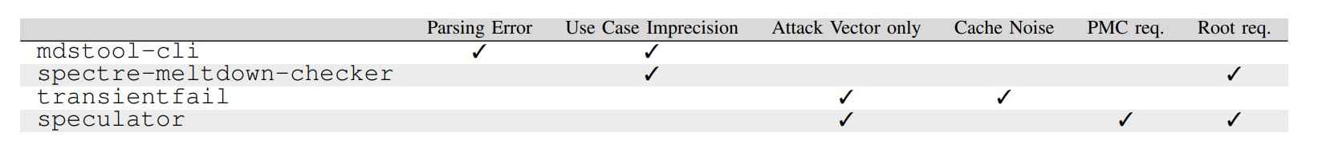
Analysis - Pitfalls

Slide 14
How can we verify the security of system?
Empirical
Information Gathering
Transientfail
Spectre-meltdown-checker
Speculator
mdstool-cli

